Slide 1
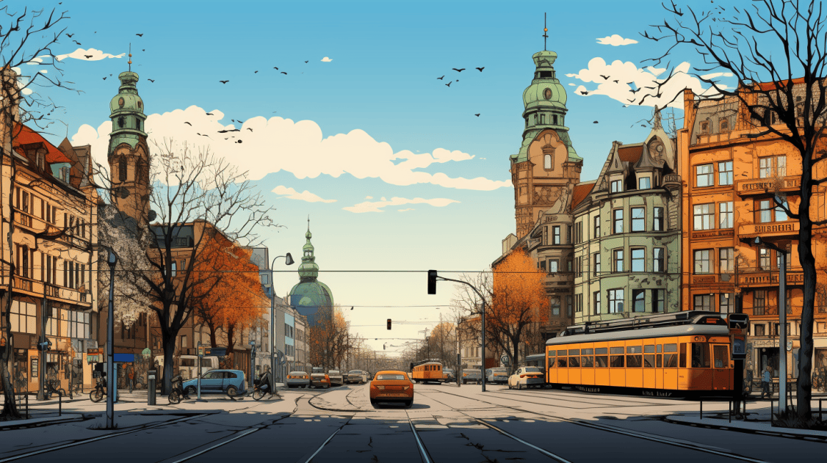
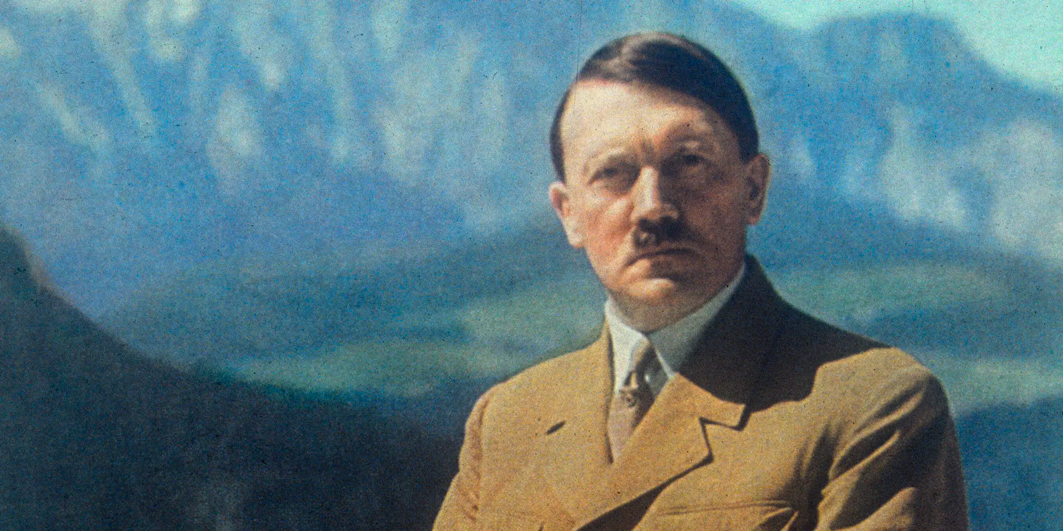
ADOLF HITLER
‘S
LEADERSHIP
Presenter:
-Aashutosh Khatiwada

Slide 2
Adolf Hitler (1889-1945) was a German politician who rose to power as the leader of the National Socialist German Workers' Party (Nazi Party). Chancellor of Germany from 1933 and Führer from 1934, he initiated World War II by invading Poland in 1939. Hitler's aggressive foreign policies led to the invasion of numerous European countries, resulting in widespread devastation and the genocide known as the Holocaust, where six million Jews were systematically murdered. His militaristic and authoritarian regime ultimately led to catastrophic consequences for Germany and the world. Hitler's ideology, based on racial purity and anti-Semitism, remains a dark chapter in history.

Slide 3
Charismatic Oratory: Hitler possessed exceptional public speaking skills, using impassioned speeches to captivate and manipulate audiences, fostering a cult of personality.
Strategic Manipulation: A master manipulator, Hitler exploited economic hardships and nationalistic sentiments to gain widespread support, effectively consolidating power.
Authoritarian Control: Hitler ruled with an iron fist, establishing a centralized and autocratic regime that suppressed dissent through fear, censorship, and persecution.

Slide 4
Propaganda Mastery: Utilizing propaganda machinery skillfully, Hitler controlled information, shaping public perception to align with his ideology and justify aggressive policies.
Strategic Vision: Hitler had a strategic vision for expanding German territory, driven by a radical ideology emphasizing Aryan supremacy and territorial conquest.
Military Leadership (Early Years): In the early stages of World War II, Hitler demonstrated strategic acumen, achieving military successes through rapid offensives, such as the Blitzkrieg tactics in Poland and France. However, his later decisions contributed to Germany's downfall.

Slide 5
CONCLUSION
Adolf Hitler's leadership ended in ruin, causing immense suffering and World War II. His aggressive policies and genocide, notably the Holocaust, left a dark and tragic legacy for Germany and the world.

Slide 6
Thank
you!

